Slide 1



Javascript – Decision Making

Slide 2
01.Run JS via Web Page
02. Comparison Operator
目录
03. Logical Operator
04. Conditional Statement

Slide 3

PART 01
Run JS via Web Page

Slide 4
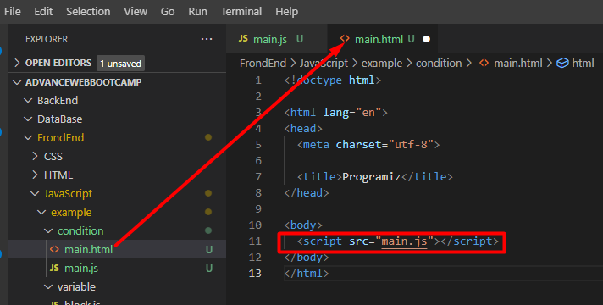
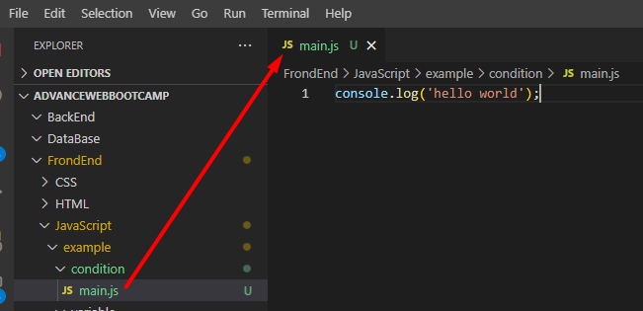
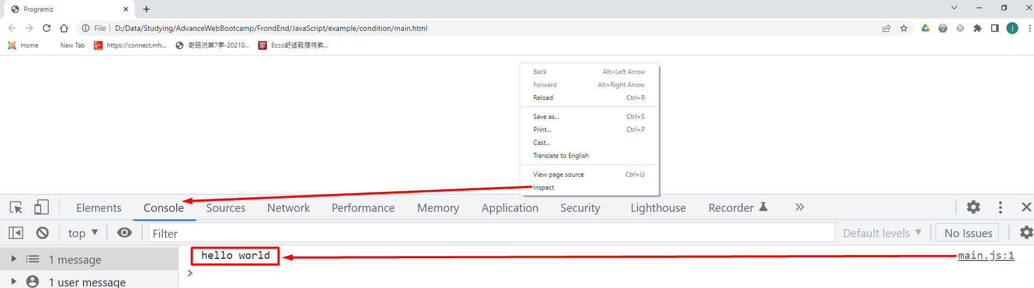
<!doctype html> <html lang="en">
<head>
<meta charset="utf-8"> <title>Programiz</title>
</head> <body>
<script src=""></script>
</body>
</html>
1. Open VS Code > Go to File > New File > Save it with .html extension. For example, main.html.
2. Copy above doctype (minimum valid HTML code) and save it in the file.
3. Create a JS file, write the following JS code and save it with .js extension like main.js.
4. From inside the HTML file, it need to link the file to use it. It can achieve that by adding the following code in main.html.
5. Open the main.html file using a browser like Chrome.
6. To check if JS code ran or not, Right click on the web page > Inspect > Choose console tab.

Slide 5
PART 02
Comparison Operator

Slide 6
Comparison Operator
Comparison operators determine equality or difference between variables or values in logical statements and give back a boolean value: either true or false
Operator | Description | Example
== | Equal to: true if the operands are equal | 5==5; //true
!= | Not equal to: true if the operands are not equal | 5!=5; //false
=== | Strict equal to: true if the operands are equal and of the same type | 5==='5'; //false
!== | Strict not equal to: true if the operands are equal but of different type or not equal at all | 5!=='5'; //true
> | Greater than: true if the left operand is greater than the right operand | 3>2; //true
>= | Greater than or equal to: true if the left operand is greater than or equal to the right operand | 3>=3; //true
< | Less than: true if the left operand is less than the right operand | 3<2; //false
<= | Less than or equal to: true if the left operand is less than or equal to the right operand | 2<=2; //true

Slide 7

Equal to Operator
== evaluates to true if the operands are equal
Note: In JavaScript, == is a comparison operator, whereas = is an assignment operator. If you mistakenly use = instead of ==, you might get unwanted result.
const a = 5, b = 2, c = 'hello’;
console.log(a == 5); // true
console.log(b == '2'); // true
console.log(c == 'Hello'); // false

Slide 8
Not Equal to Operator
!= evaluates to true if the operands are not equal
const a = 3, b = 'hello’;
console.log(a != 2); // true console.log(b != 'Hello'); // true

Slide 9
Strict Equal to Operator
=== evaluates to true if the operands are equal and of the same type
Note: The difference between == and === is that:
== evaluates to true if the operands are equal, however, === evaluates to true only if the operands are equal and of the same type
const a = 2;
console.log(a === 2); // true console.log(a === '2'); // false

Slide 10
Strict Not Equal to Operator
!== evaluates to true if the operands are strictly not equal
Note: In the above example, 2 !== '2' gives true. It's because their types are different even though they have the same value.
const a = 2, b = 'hello’;
console.log(a !== 2); // false console.log(a !== '2'); // true console.log(b !== 'Hello'); // true

Slide 11
PART 03
Logical Operator

Slide 12
Logical Operators
Logical operators determine the logic between variables or values



AND
OR
NOT
&&
||
!
Operator | Description | Example
&& | true if both the operands/boolean values are true, else evaluates to false | true && false; // false
|| | true if either of the operands/boolean values is true. evaluates to false if both are false | true || false; // true
! | true if the operand is false and vice-versa. | !true; // false

Slide 13
Logical AND Operator
const a = true, b = false; const c = 4;
console.log(a && a); // true
console.log(a && b); // false console.log((c > 2) && (c < 2)); // false
&& evaluates to true if both the operands are true, else evaluates to false.
AND

Slide 14
Logical OR Operator
const a = true, b = false, c = 4;
console.log(a || b); // true
console.log(b || b); // false console.log((c>2) || (c<2)); // true
|| evaluates to true if either of the operands is true. If both operands are false, the result is false
OR

Slide 15
Logical NOT Operator
const a = true, b = false;
console.log(!a); // false
console.log(!b); // true
! evaluates to true if the operand is false and vice-versa
NOT

Slide 16
PART 04
Conditional Statement

Slide 17
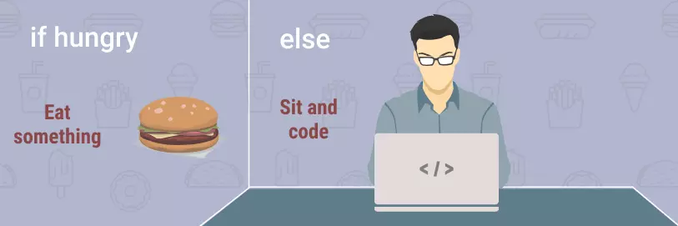
Mak Decision in Code
let hungry = true;
if (hungry) {
console.log('eat something then code');
} else {
console.log('Sit and code');
}

Slide 18
Conditional Types
if
If ‧ ‧ ‧ else
Statement Syntax
If ‧ ‧ ‧ else if ‧ ‧ ‧ else
switch

Slide 19
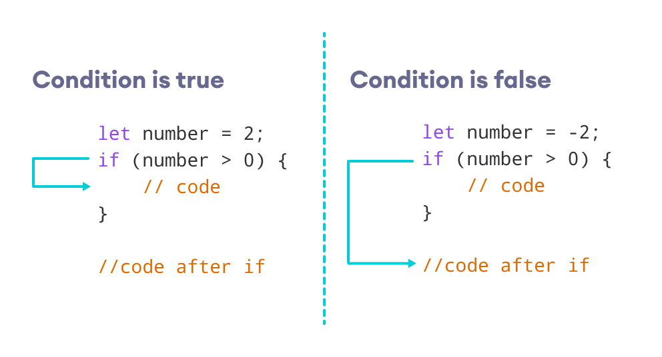
If Statement

Slide 20
Example
const number = prompt("Enter a number: ");
// check if number is greater than 0
if (number > 0) {
// the body of the if statement
console.log("The number is positive");
}
console.log("The if statement is easy");
Enter a number: 2
The number is positive
The if statement is easy
Enter a number: -1
The if statement is easy

Slide 21
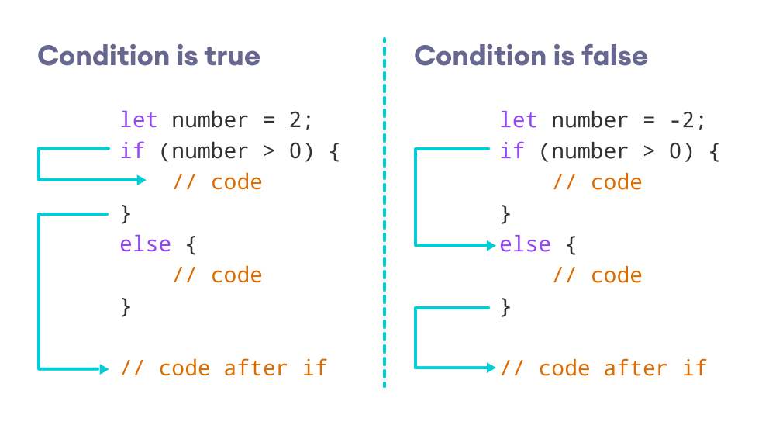
If ‧ ‧ ‧ else Statement

Slide 22
Example
const number = prompt("Enter a number: "); if (number > 0) {
console.log("The number is positive");
}
else {
console.log("The number is either a negative number or 0");
} console.log("The if...else statement is easy");
Enter a number: 2
The number is positive The if...else statement is easy
Enter a number: -1
The number is either a negative number or 0
The if...else statement is easy

Slide 23
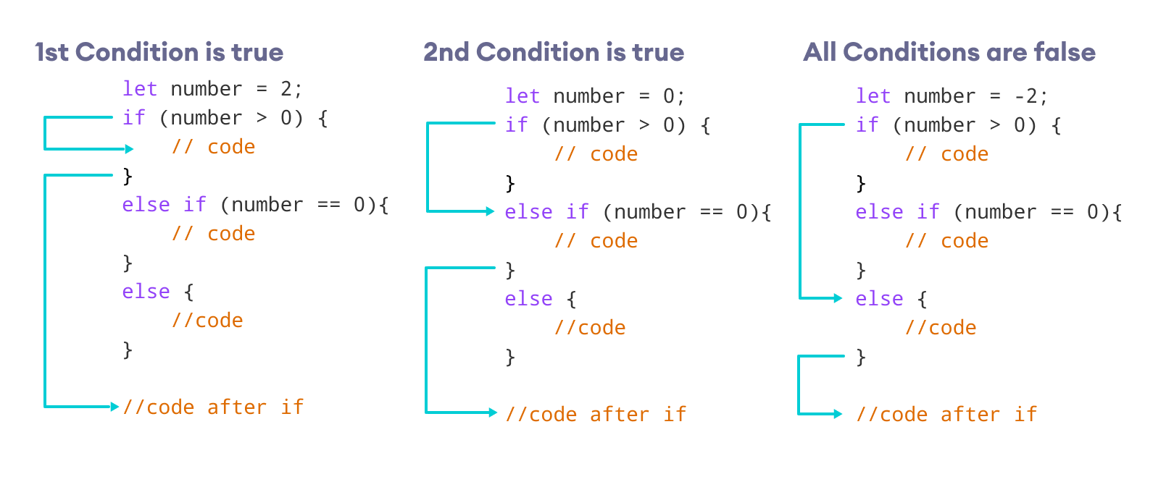
If ‧ ‧ ‧ else if Statement

Slide 24
Example
const number = prompt("Enter a number: ");
if (number > 0) {
console.log("The number is positive");
}
else if (number == 0) {
console.log("The number is 0");
}
else {
console.log("The number is negative");
} console.log("The if...else if...else statement is easy");
Enter a number: 0
The number is 0
The if...else if...else statement is easy

Slide 25
Nested if ‧ ‧ ‧ else Statement
const number = prompt("Enter a number: "); if (number >= 0) {
if (number == 0) {
console.log("You entered number 0");
} else {
console.log("You entered a positive number");
}
} else {
console.log("You entered a negative number");
}
Enter a number: 5
You entered a positive number

Slide 26
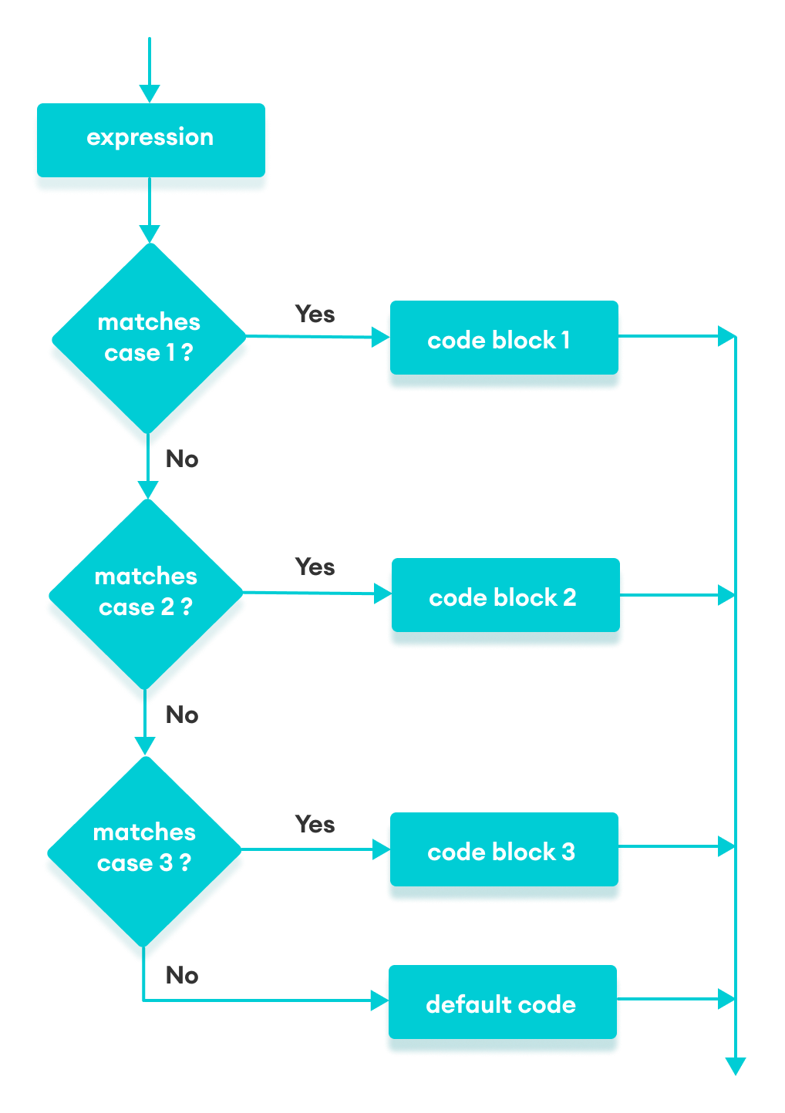
Switch Statement Flowchart
switch(variable/expression) {
case value1:
// body of case 1
break; case value2:
// body of case 2
break; case valueN:
// body of case N
break; default:
// body of default
}

Slide 27
Simple Program by Switch
let a = 2; switch (a) { case 1:
a = 'one';
break;
case 2:
a = 'two';
break;
default:
a = 'not found';
break;
}
console.log(`The value is ${a}`)
The value is two.

Slide 28
Type Checking by Switch
let a = 1; switch (a) {
case "1":
a = 1;
break;
case 1:
a = 'one';
break;
case 2:
a = 'two';
break;
default:
a = 'not found';
break;
}
console.log(`The value is ${a}`);
The value is one.

Slide 29
Simple Calculator by Switch
let result;
const operator = prompt('Enter operator ( either +, -, * or / ): ');
const number1 = parseFloat(prompt('Enter first number: '));
const number2 = parseFloat(prompt('Enter second number: ')); switch(operator) {
case '+':
result = number1 + number2;
console.log(`${number1} + ${number2} = ${result}`);
break;
case '-':
result = number1 - number2;
console.log(`${number1} - ${number2} = ${result}`);
break;
case '*':
result = number1 * number2;
console.log(`${number1} * ${number2} = ${result}`);
break;
case '/':
result = number1 / number2;
console.log(`${number1} / ${number2} = ${result}`);
break;
}
Enter operator: +
Enter first number: 4
Enter second number: 5
4 + 5 = 9

Slide 30
Thank You!

